Slide 1




R&D and Innovation Policies for the Marketplace
Joint workshop on firms, industries and productivity
Welcome
On behalf of the OECD Global Forum on Productivity
Peter Gal
Senior Economist
and Project Manager of the GFP
OECD
Lisboa (INE) | September 16, 2019

Slide 2
The Global Forum on Productivity
What is it?
  Founded in 2015 at Productivity Summit in Mexico
  A forum of currently 19 member countries,
  both OECD and non-OECD, aided by the OECD Secretariat
  It supports policymakers in designing successful productivity-enhancing policies through 3 main activities:
    Research and analysis
    Convening events (conferences, workshops)
    Communication
  …in collaboration with our members
  … leveraging on the joint expertise of several OECD teams

Slide 3
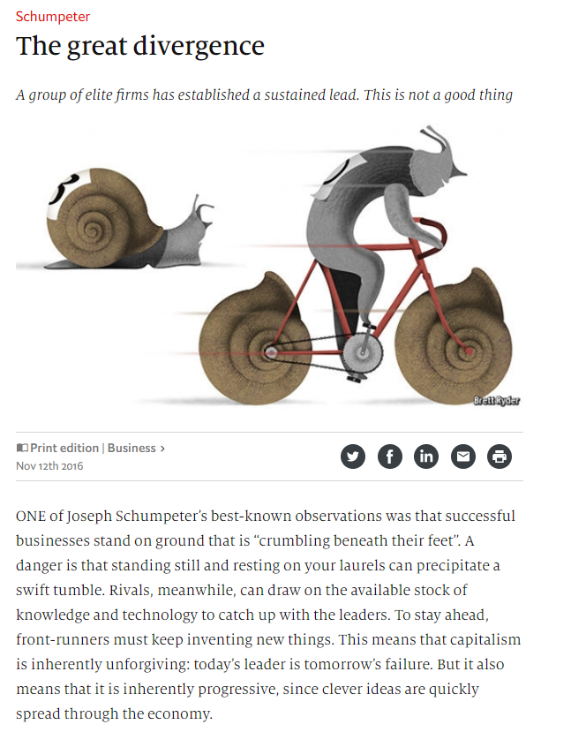
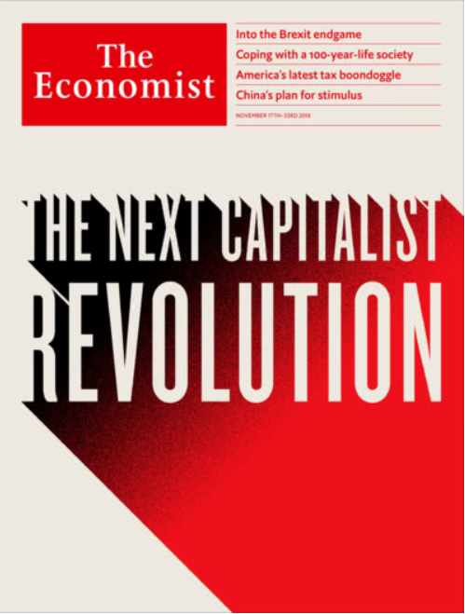
Research & Analysis
…and its impact
Shaping the dialogue in policy discussions
  Best vs. Rest: Beyond the representative firm,
  about frontier firms and laggards…
  Industry Concentration: About superstars,
  winner-takes-most, mergers and competition…
Broad press coverage and publicity
Shaping the research agenda:
From Macro to Micro
  At first, went beyond aggregate and
  industry-level data to firm-level
  Now linked employer-employee data to look
  into firms: “Human Side of Productivity”
  Also looked at role of GVCs at the firm
  and now (forthcoming) at the industry level

Slide 4


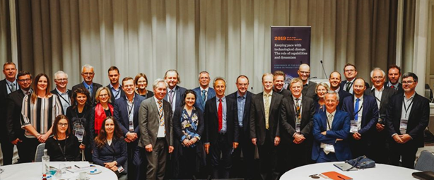
Events
Our annual GFP conferences
Mexico 2015
Portugal 2016
Hungary 2017
Canada 2018
Australia 2019

Slide 5
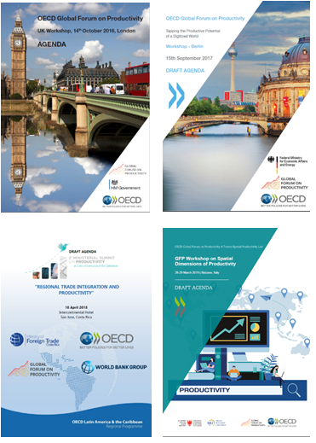
Events
Workshops & Ministerials
Chile 2016
Costa Rica 2018
UK 2016
Italy 2019
Germany 2017
Portugal 2019

Slide 6


Thank you and
enjoy the workshop!
For more information, please visit
OE.CD/GFP
Or reach us at
Productivity@OECD.org

